Slide 1
Creating Shape files for Varanasi
Ammar Bin Zulqarnain

Slide 2
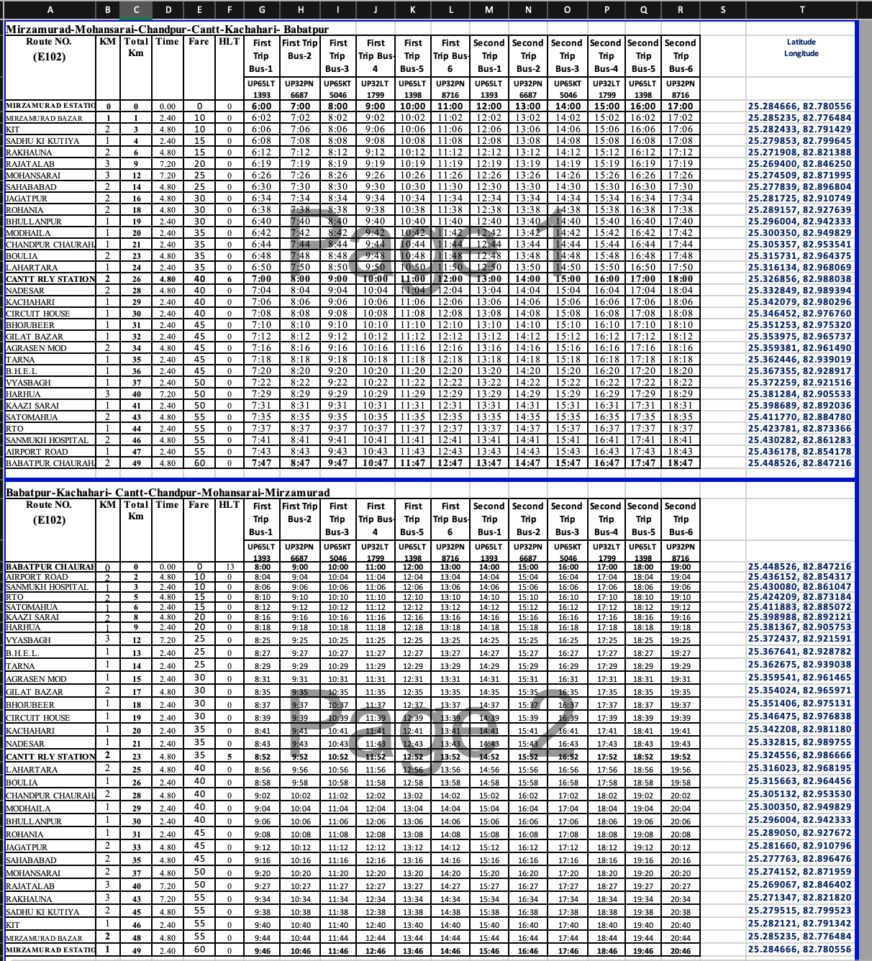
Example Route Sheet

Slide 3
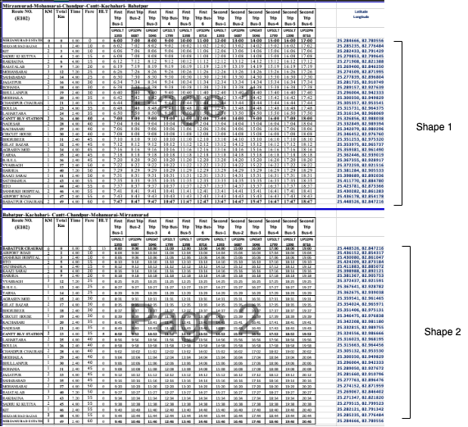
Creating a DataFrame with Shapes
Each table for each route sheet has its own shape from starting stop to last stop.
The shape is not complete because we don’t have linestring of geographical coordinates between two consecutive stops for each table
Hence, I used MapBox Direction API to generate these coordinates

Slide 4
Shapes.txt features
Features:
shape_id: shape of the route
shape_pt_lat: Latitude of a point visited in the trip
shape_pt_lon: longitude of a point visited in the trip
shape_pt_sequence: Sequence number of the point in the shape

Slide 5
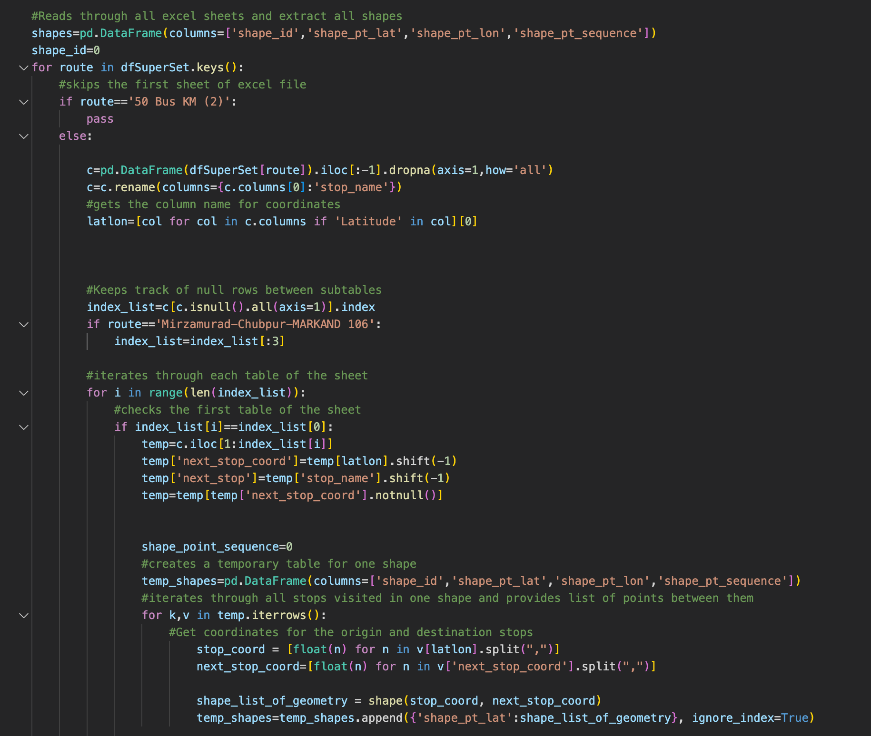
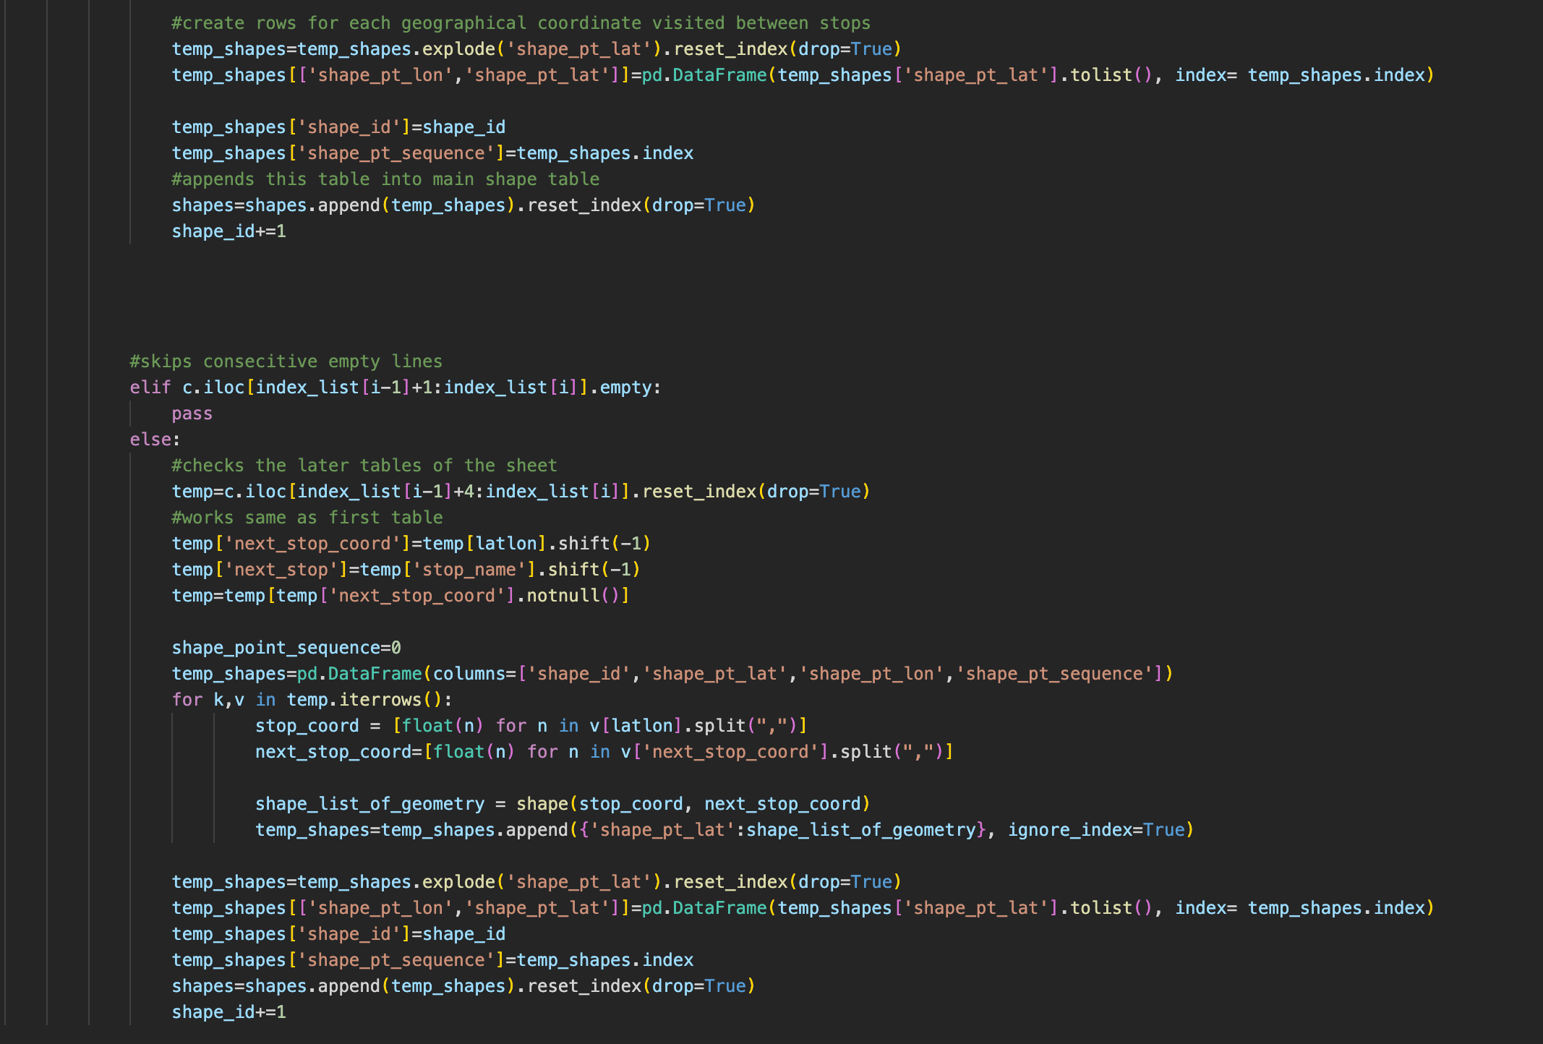
Overall Code
Iterates over all route sheets and then creates temporary shape data frames for each subtables
Each temporary shape data frames is appended into main shapes data frame

Slide 6
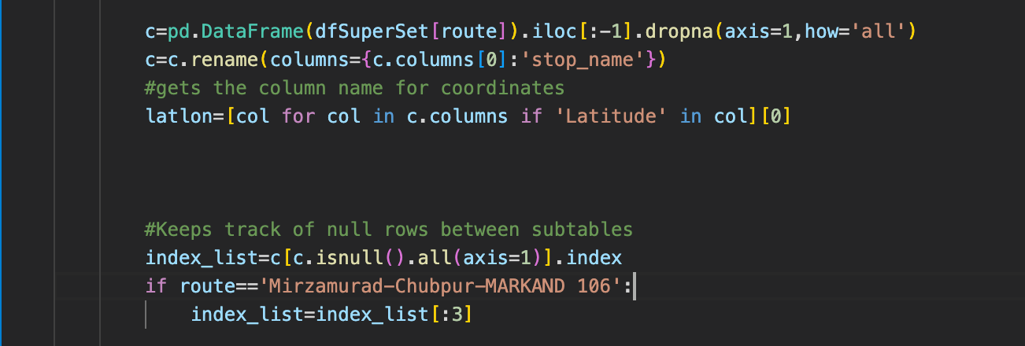
Code Snippets for creating a Data Frame with Shapes
This code snippet converts an excel sheet containing information of one route into a pandas data frame. index_list stores indices where the rows are null (separating two subtables)
DfSuperSet stores all excel sheets of all routes

Slide 7
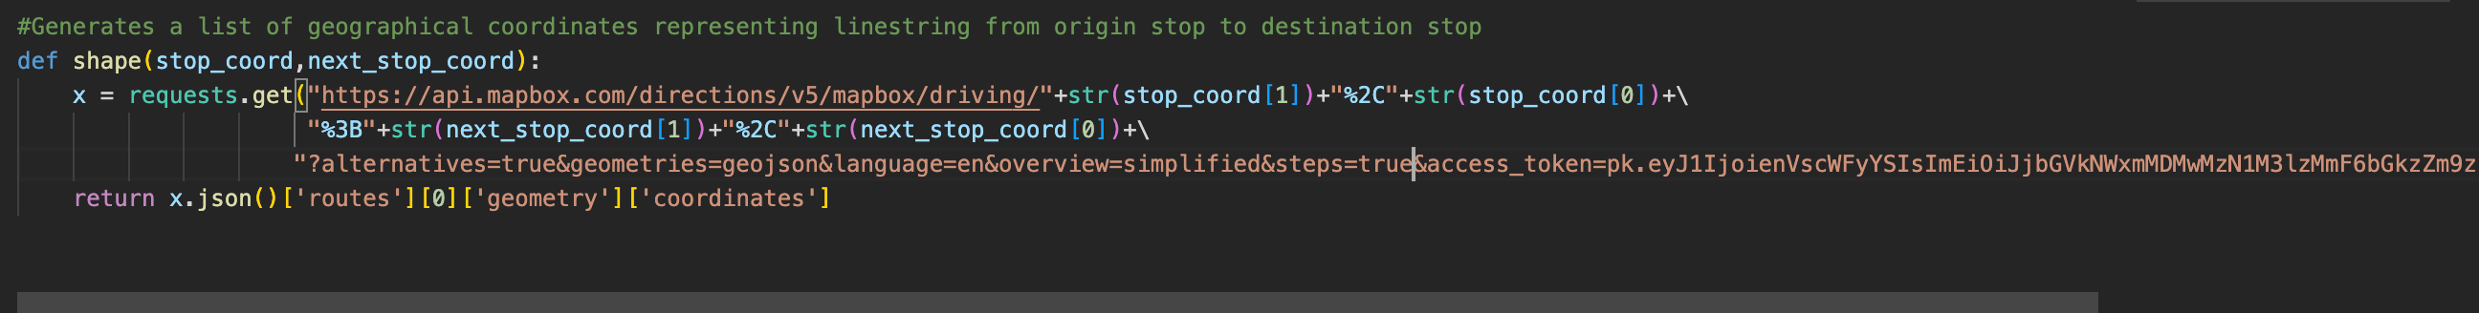
Code Snippets for creating a Data Frame with Shapes
This function takes the coordinates of two consecutive stops of a shape and generates a list of geographical coordinates it will visit in between the two stops

Slide 8
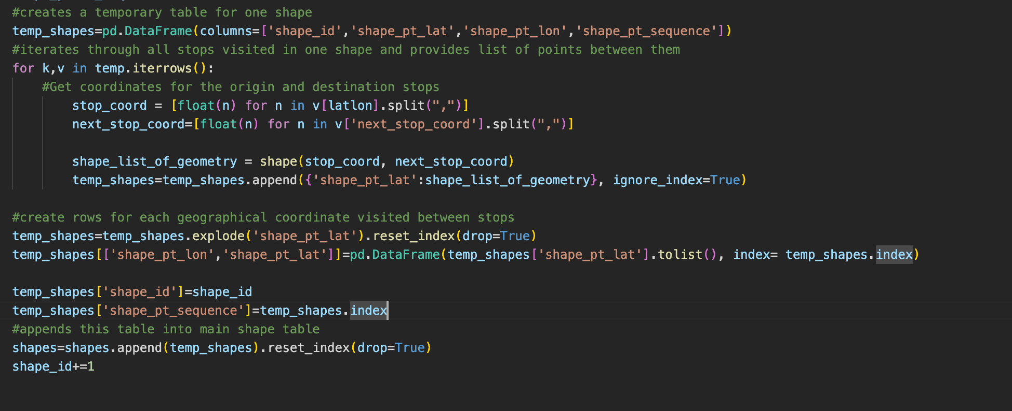
Code Snippets for creating a Data Frame with Shapes
This code snippet iterates through each table and call shape function for each consecutive stops. It then stores all the geographical coordinates between stops as rows and append it to main shapes data frame

Slide 9
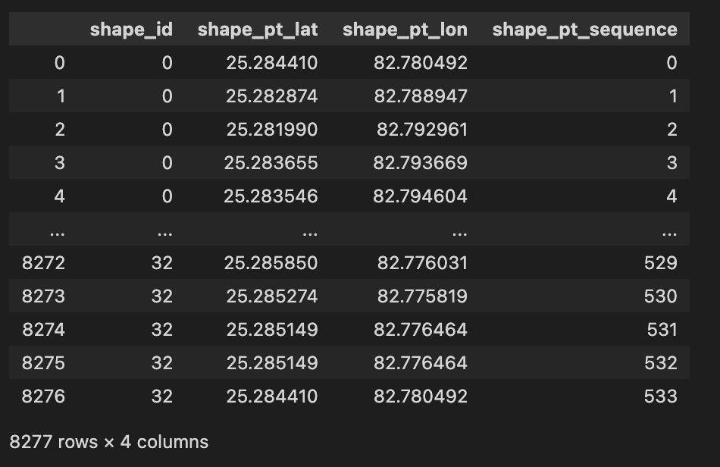
Shapes Data Frame

